Slide 1
การใช้แบบจำลอง DTN เพื่อศึกษาแนวโน้มการแพร่กระจายของโรคระบาด

Slide 2
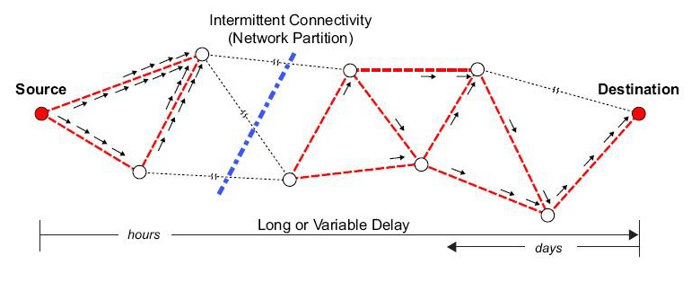
What IS Delay Tolerant Network?

Slide 3
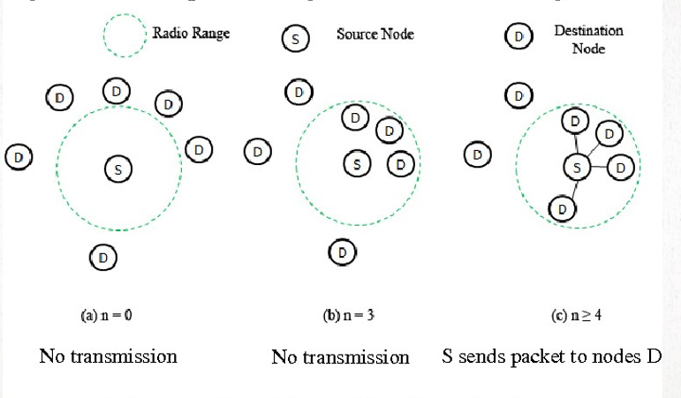
DTN Epidemic routing & Disease spreading.

Slide 4
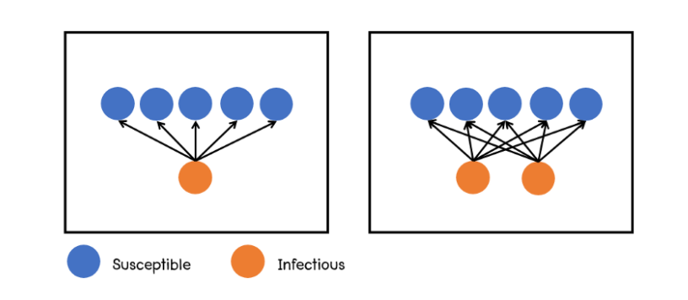
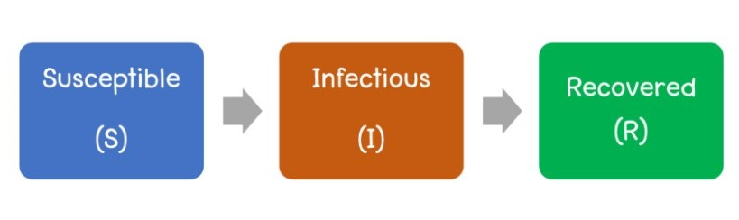
Disease spreading model.

Slide 5
Performance Goal & Metric.
Goal : compare performance spreading between
Node amount (Population)
Transmission Range.
Time To Live (Time to recover/Time to killed host)
Area (If using SI model.)
Metric
Time spend for population infected to 99%
highest population infected.
Transmission Rate

Slide 6
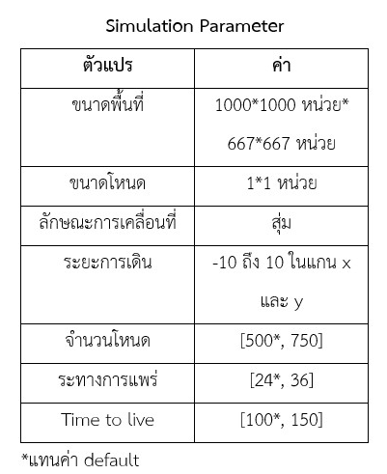
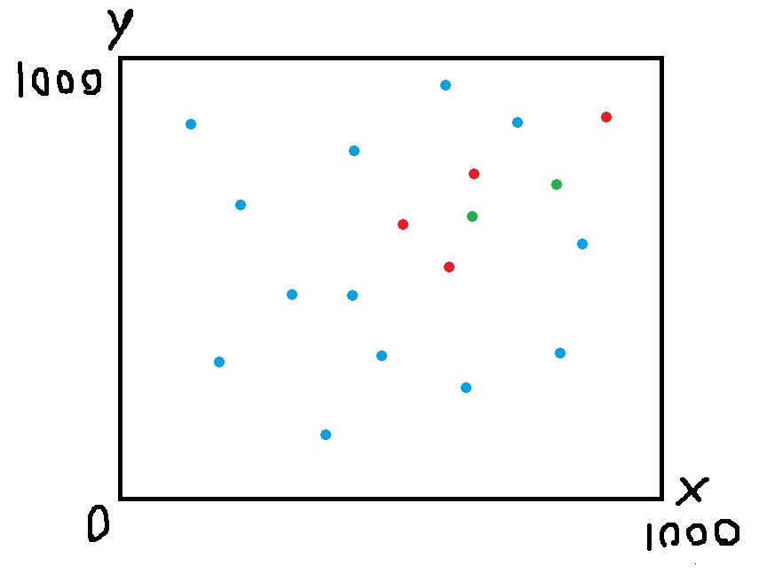
Simulation Model overview

Slide 7
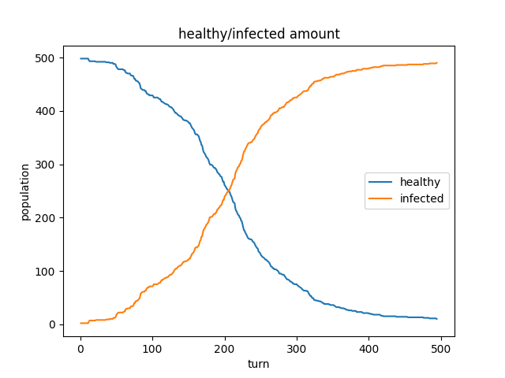
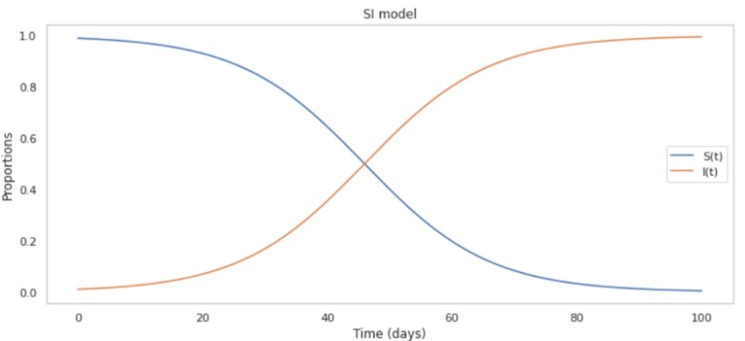
Comparing SI model

Slide 8
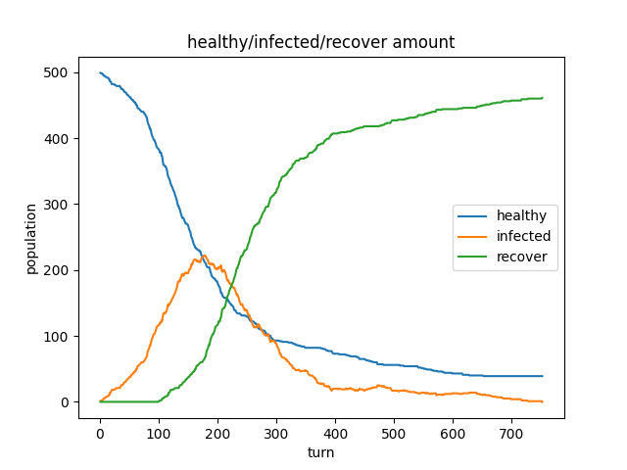
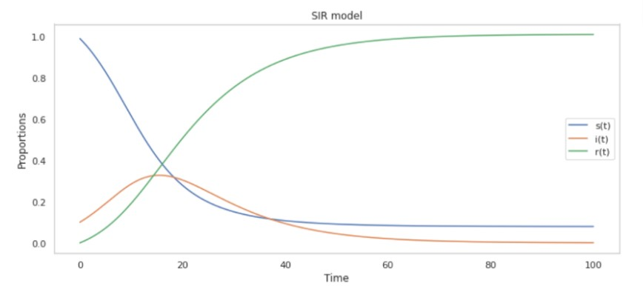
Comparing SIR model

Slide 9
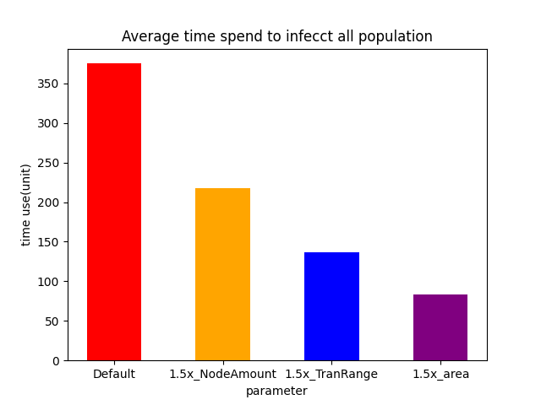
Time spend for population infected to 99%

Slide 10
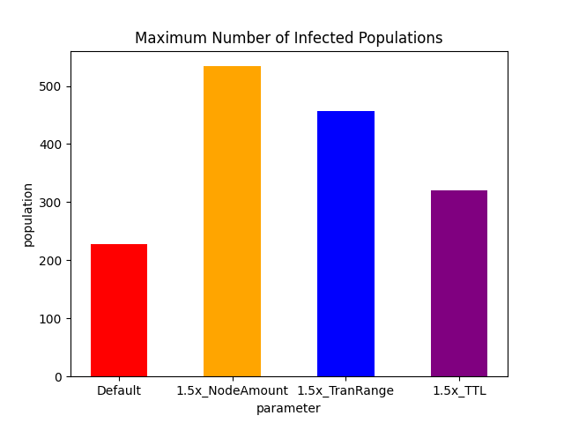
highest population infected.

Slide 11
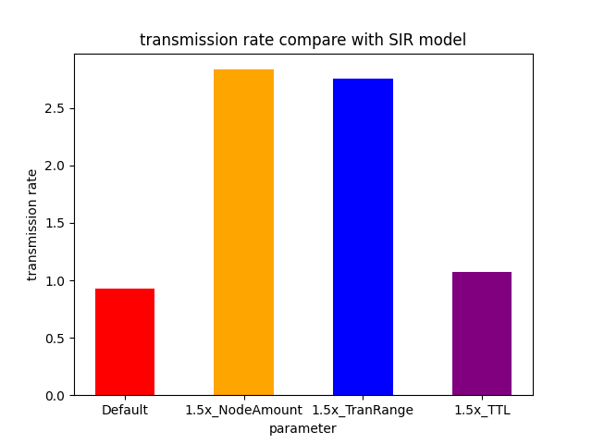
Transmission Rate

Slide 12
CONCLUSION
See more at github.com/FameIllusionMaya/DTN-Virus

